Slide 1
Applied Physics NS (101)

Slide 2
What causes “weightlessness”?
Even in the space shuttle, there is a force of attraction exerted by the earth on the shuttle and its contents.
When the space shuttle temporarily “falls” toward the earth, the contents of the space shuttle appear to be weightless, but in fact they are falling with the space shuttle. This is called “freefall”.

Slide 3

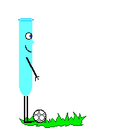

Newton’s Second Law
The acceleration of an object is directly proportional to the net force acting on it and inversely proportional to its mass.
When mass is in kilograms and acceleration is in m/s/s, the unit of force is in Newtons (N).
One Newton is equal to the force required to accelerate one kilogram of mass at one meter/second/second

Slide 4
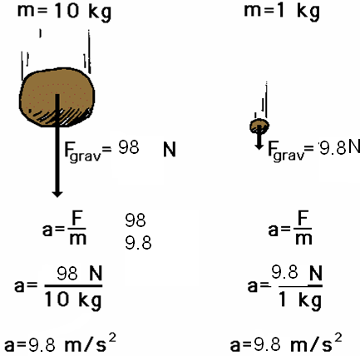
Newton’s 2nd Law proves that different masses accelerate to the earth at the same rate, but with different forces.
We know that objects with different masses accelerate to the ground at the same rate.
However, because of the 2nd Law we know that they don’t hit the ground with the same force.
F = ma
98 N = 10 kg x 9.8 m/s/s
F = ma
9.8 N = 1 kg x 9.8 m/s/s

Slide 5


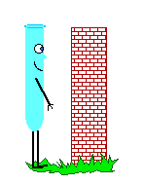
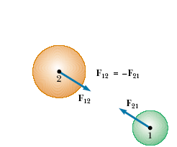
Newton’s Third Law
For every action, there is an equal and opposite reaction.

Slide 6

Newton’s 3rd Law in Nature
Consider the propulsion of a fish through the water. A fish uses its fins to push water backwards. In turn, the water reacts by pushing the fish forwards, propelling the fish through the water.
The size of the force on the water equals the size of the force on the fish; the direction of the force on the water (backwards) is opposite the direction of the force on the fish (forwards).

Slide 7

3rd Law
Flying gracefully through the air, birds depend on Newton’s third law of motion. As the birds push down on the air with their wings, the air pushes their wings up and gives them lift.

Slide 8

Consider the flying motion of birds. A bird flies by use of its wings. The wings of a bird push air downwards. In turn, the air reacts by pushing the bird upwards.
The size of the force on the air equals the size of the force on the bird; the direction of the force on the air (downwards) is opposite the direction of the force on the bird (upwards).
Action-reaction force pairs make it possible for birds to fly.

Slide 9
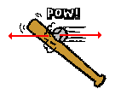

Other examples of Newton’s Third Law
The baseball forces the bat to the left (an action); the bat forces the ball to the right (the reaction).

Slide 10

3rd Law
The reaction of a rocket is an application of the third law of motion. Various fuels are burned in the engine, producing hot gases.
The hot gases push against the inside tube of the rocket and escape out the bottom of the tube. As the gases move downward, the rocket moves in the opposite direction.

Slide 11
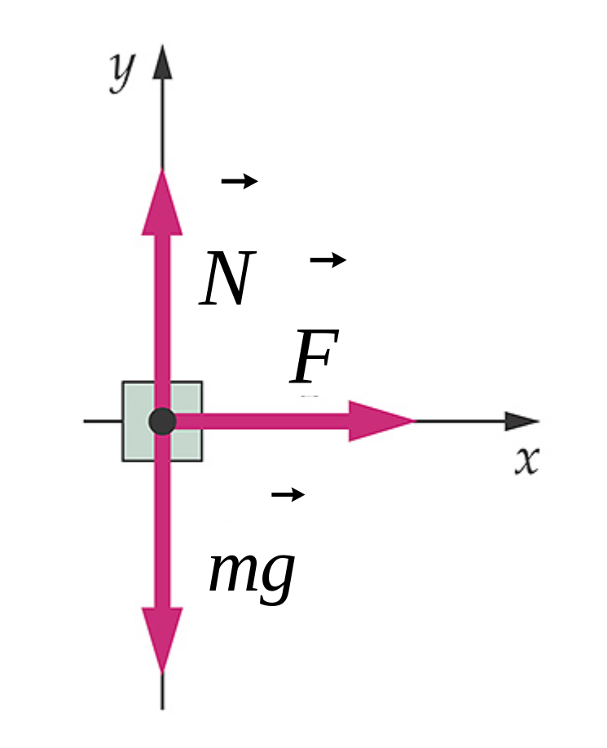
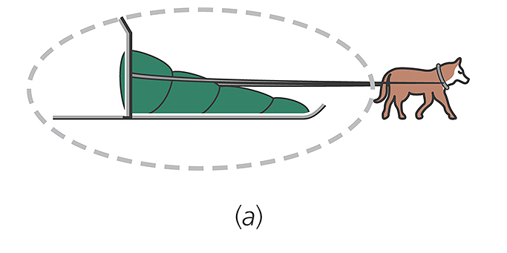
Free Body Diagram

Slide 12
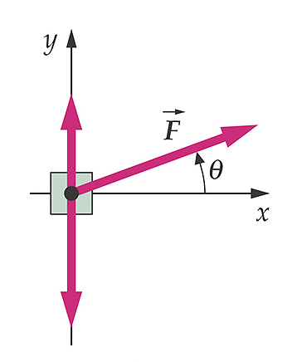
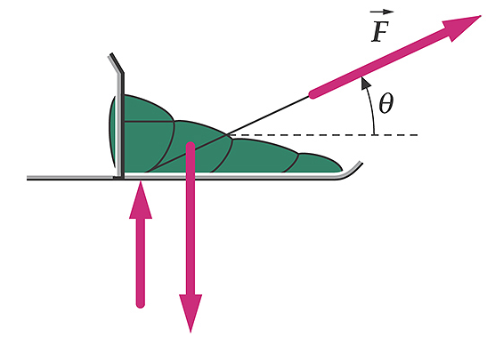
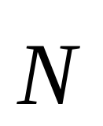
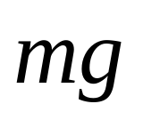
Same problem but the applied force is angled up

Slide 13
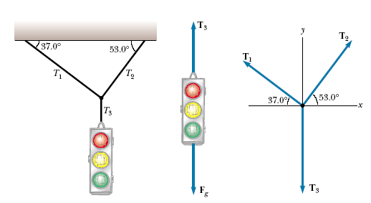



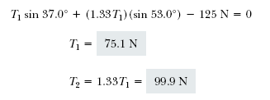

APPLICATIONS OF NEWTON’S LAWS
A Traffic Light at Rest

Slide 14
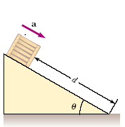


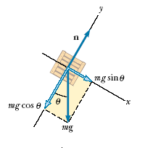

Crate on a Frictionless Incline

Slide 15
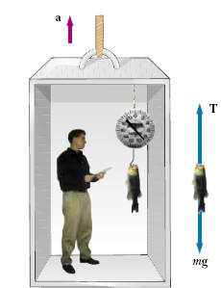
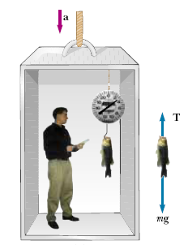

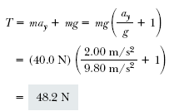

Weighing a Fish in an Elevator
A person weighs a fish of mass m on a spring scale attached to
the ceiling of an elevator, as illustrated in Figure. Show that if the elevator accelerates either upward or downward, the spring scale gives a reading that is different from the weight of the fish.
If the elevator is either at rest or moving at constant velocity, the fish is not accelerating, and so or (remember that the scalar mg
is the weight of the fish).T = mg
If the elevator moves upward with an acceleration a relative to an observer standing outside the elevator in an inertial frame.
The scale reading T is greater than the weight mg if a is upward, so that ay is positive, and that the reading is less than mg if a is downward, so that ay is negative.

Slide 16
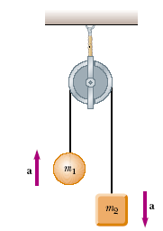

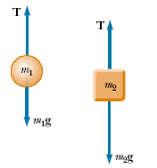



Atwood’s Machine
When two objects of unequal mass are hung vertically over a
frictionless pulley of negligible mass, Determine the magnitude of the acceleration of the two objects and the tension in the lightweight
cord.

Slide 17

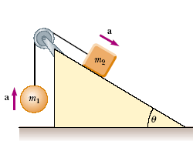



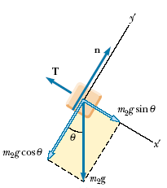

Acceleration of Two Objects Connected by a Cord
A ball of mass m1 and a block of mass m2 are attached by a lightweight cord that passes over a frictionless pulley of negligible mass, as shown in Figure. The block lies on a frictionless incline of angle . Find the magnitude of the acceleration of the two objects and the tension in the cord.

Slide 18
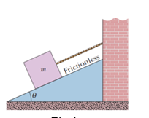
In Fig let the mass of the block be 8.5 kg and the angle be 30 .Find (a) the tension in the cord and (b) the normal force acting on the block. (c) If the cord is cut, find the magnitude of the resulting acceleration of the block.

